Slide 1
BUILDING ROBUST STATE MANAGEMENT APP WITH NGRX V8
NGO HUNG PHUC

Slide 2
AGENDA
State management with NGRX
NGRX Diagram
Object, Array & HashMap
What’s new in NGRX 8
NGRX Entity, NGRX Effects, NGRX Router Store, NGRX schematic
What is a good action hygiene ?
TSLint rules for NgRx
Demo

Slide 3
State management with NGRX
NGRX Store provides reactive state management for Angular apps inspired by Redux. Unify the events in your application and derive state using RxJS.
NgRx Effects gives you a framework for isolating side effects from your components by connecting observables of actions to your store.
NgRx Schematics helps you avoid writing common boilerplate and instead focus on building your application

Slide 4
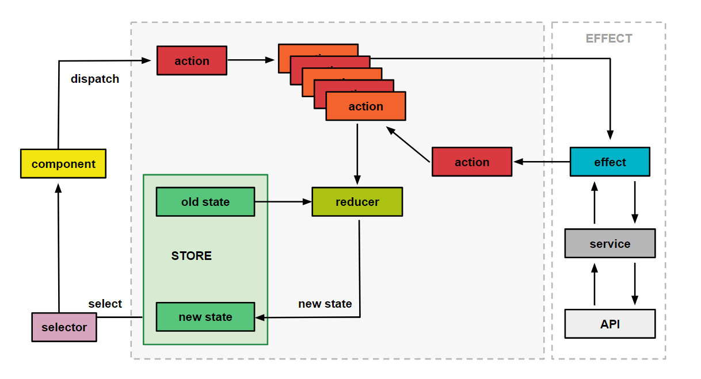
NGRX Diagram

Slide 5
Object, Array & HashMap
https://medium.com/front-end-weekly/es6-map-vs-object-what-and-when-b80621932373

Slide 6
What’s new in NGRX 8
Provided new way to defined actions, reducers, effects
Actions: createAction
Reducers: createReducer
Selectors: createSelector
Effects: createEffect
Entity: createEntityAdapter

Slide 7
NGRX Entity
Entity State adapter for managing record collections.
Entity provides an API to manipulate and query entity collections.
Reduces boilerplate for creating reducers that manage a collection of models.
Provides performance CRUD operations for managing entity collections.
Extensible type-safe adapters for selecting entity information.

Slide 8
NGRX Effects
Effects isolate side effects from components, allowing for more pure components that select state and dispatch actions.
Effects are long-running services that listen to an observable of every action dispatched from the Store.
Effects filter those actions based on the type of action they are interested in. This is done by using an operator.
Effects perform tasks, which are synchronous or asynchronous and return a new action.

Slide 9
NGRX Router Store
Bindings to connect the Angular Router with Store.
During each router navigation cycle, multiple actions are dispatched that allow you to listen for changes in the router's state.
You can then select data from the state of the router to provide additional information to your application.

Slide 10
NGRX Schematic
Scaffolding library for Angular applications using NgRx libraries.
Schematics provides Angular CLI commands for generating files when building new NgRx feature areas and expanding existing ones. Built on top of Schematics, this tool integrates with the Angular CLI.

Slide 11
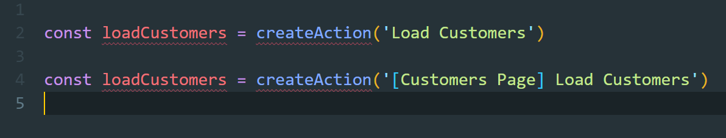
What is good action hygiene ?
Action that follow the "[Source] Event" convention
Example

Slide 12
TSLint rules for NgRx
ngrx-action-hygiene | Enforces the use of good action hygiene
ngrx-effect-creator-and-decorator | An Effect should only use the effect creator (createEffect) or the Effect decorator (@Effect), but not both simultaneously
ngrx-no-duplicate-action-types | An action type must be unique
ngrx-unique-reducer-actions | An action can't be handled multiple times in the same reducer

Slide 13
DEMO

